Slide 1
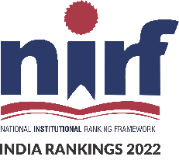


University Institute of Engineering
DEPARTMENT OF COMPUTER SCIENCE & ENGINEERING
Subject Name: Software Engineering
Subject Code: 23CST-206
Software Maintenance and Reuse
Er. Jagmeet Kaur
E8387
ASSISTANT PROFESSOR
CSE
DISCOVER . LEARN . EMPOWER

Slide 2
Chapter-9 Software Maintenance and Reuse
Software Maintenance
Types of Maintenance
Software Maintenance Models

Slide 3
Software Maintenance and Reuse
CO4 | Prepare Test Suite and Quality Assurance plan for a given project.
CO5 | Understand and analyse software management principles.

Slide 4
Software Maintenance
Software Maintenance is the process of modifying a software product after it has been delivered to the customer.
The main purpose of software maintenance is to modify and update software application after delivery to correct faults and to improve performance.

Slide 5
Need for Maintenance
Software Maintenance must be performed in order to:
Correct faults.
Improve the design.
Implement enhancements.
Interface with other systems.
Accommodate programs so that different hardware, software, system features, and telecommunications facilities can be used.
Migrate legacy software.
Retire software.

Slide 6
Why are modifications required?
There are number of reasons, why modifications are required, some of them are briefly mentioned below:
Market Conditions - Policies, which changes over the time, such as taxation and newly introduced constraints like, how to maintain bookkeeping, may trigger need for modification.
Client Requirements - Over the time, customer may ask for new features or functions in the software.
Host Modifications - If any of the hardware and/or platform (such as operating system) of the target host changes, software changes are needed to keep adaptability.
Organization Changes - If there is any business level change at client end, such as reduction of organization strength, acquiring another company, organization venturing into new business, need to modify in the original software may arise.

Slide 7
Categories of Software Maintenance
Maintenance can be divided into the following:
Corrective maintenance: Corrective maintenance of a software product may be essential either to rectify some bugs observed while the system is in use, or to enhance the performance of the system.
Adaptive maintenance: This includes modifications and updations when the customers need the product to run on new platforms, on new operating systems, or when they need the product to interface with new hardware and software.

Slide 8
Categories of Software Maintenance
Perfective maintenance: A software product needs maintenance to support the new features that the users want or to change different types of functionalities of the system according to the customer demands.
Preventive maintenance: This type of maintenance includes modifications and updations to prevent future problems of the software. It goals to attend problems, which are not significant at this moment but may cause serious issues in future.

Slide 9
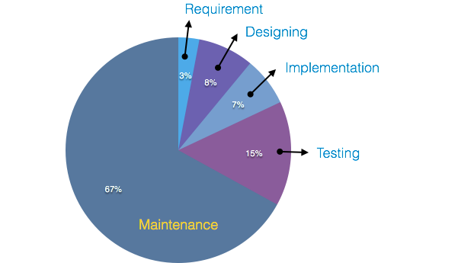
Cost of Maintenance
On an average, the cost of software maintenance is more than 50% of all SDLC phases. There are various factors, which trigger maintenance cost go high.

Slide 10
Real-world factors affecting Maintenance Cost
The standard age of any software is considered up to 10 to 15 years.
Older software's, which were meant to work on slow machines with less memory and storage capacity cannot keep themselves challenging against newly coming enhanced software on modern hardware.
As technology advances, it becomes costly to maintain old software.
Most maintenance engineers are newbie and use trial and error method to rectify problem.
Often, changes made can easily hurt the original structure of the software, making it hard for any subsequent changes.
Changes are often left undocumented which may cause more conflicts in future.

Slide 11
Software-end factors affecting Maintenance Cost
Structure of Software Program
Programming Language
Dependence on external environment
Staff reliability and availability

Slide 12
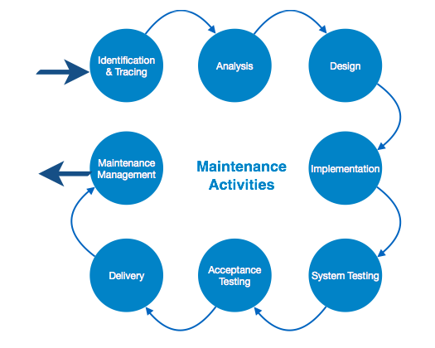
Maintenance Activities

Slide 13
Maintenance Activities
These activities go hand-in-hand with each of the following phase:
Identification & Tracing - It involves activities pertaining to identification of requirement of modification or maintenance. It is generated by user or system may itself report via logs or error messages. Here, the maintenance type is classified also.
Analysis - The modification is analyzed for its impact on the system including safety and security implications. If probable impact is severe, alternative solution is looked for. A set of required modifications is then materialized into requirement specifications. The cost of modification/maintenance is analyzed and estimation is concluded.

Slide 14
Maintenance Activities
Design - New modules, which need to be replaced or modified, are designed against requirement specifications set in the previous stage. Test cases are created for validation and verification.
Implementation - The new modules are coded with the help of structured design created in the design step. Every programmer is expected to do unit testing in parallel.

Slide 15
Maintenance Activities
System Testing - Integration testing is done among newly created modules. Integration testing is also carried out between new modules and the system. Finally the system is tested as a whole, following regressive testing procedures.
Acceptance Testing - After testing the system internally, it is tested for acceptance with the help of users. If at this state, user complaints some issues they are addressed or noted to address in next iteration.

Slide 16
Maintenance Activities
Delivery - After acceptance test, the system is deployed all over the organization either by small update package or fresh installation of the system. The final testing takes place at client end after the software is delivered.
Training facility is provided if required, in addition to the hard copy of user manual.
Maintenance management - Configuration management is an essential part of system maintenance. It is aided with version control tools to control versions, semi-version or patch management.

Slide 17
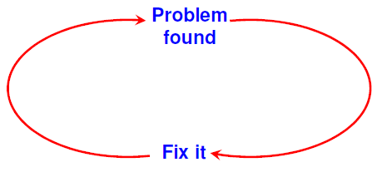
Software Maintenance Process Models
The activities involved in a software maintenance project are not unique and depend upon several factors like extent of modification required, conditions of existing product, resource availability to maintenance team, expected project risks etc.
The following maintenance models have been proposed:
Quick-fix Model
It is an adhoc approach to maintain the software. It is a fire fighting approach, waiting for the problem to occur and then trying to fix it as quickly as possible.

Slide 18
Software Maintenance Process Models
Iterative Enhancement Model
The iterative enhancement model, which was originally proposed as a process model, can be easily adapted for maintaining a software system. It considers that the changes made to the software system are iterative in nature.
It involves following stages:
Requirement analysis
The requirements for change are analyzed to begin the software maintenance process
Classification of requested modifications
After analysis, the requested modifications are classified according to the complexity, technical issues, and identification of modules that will be affected.

Slide 19
Software Maintenance Process Models
Implementation of requested modifications
At the end, the software is modified to implement the modification request. At each stage, the documentation is updated to accommodate changes of requirements analysis, design, coding and testing phases. It is essential to have a complete documentation before implementation of iterative enhancement model begins.

Slide 20
Software Maintenance Process Models
Reuse-oriented Model
The reuse-oriented model assumes that the existing program components can be reused to perform maintenance. This approach can be represented by a reverse engineering cycle followed by a forward engineering cycle. It is also known as software reengineering.
The old code is analyzed to extract the module specifications. The module specifications are then analyzed to produce the design.
The design is analyzed(abstracted) to produce the original requirements specification.
The change requests are then applied to this requirements specification to generate new requirements specification. Then forward engineering is applied to finally apply the changes to the code.

Slide 21
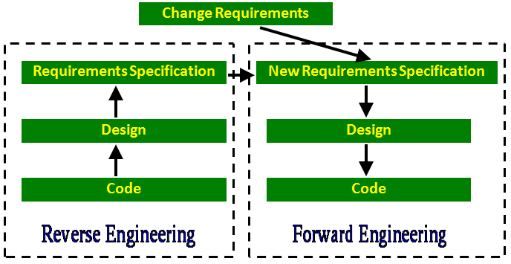
Software Maintenance Process Models

Slide 22
References
https://www.javatpoint.com/software-engineering-software-maintenance
https://www.tutorialspoint.com/software_engineering/software_maintenance_overview.htm
https://www.geeksforgeeks.org/software-engineering-software-maintenance/

Slide 23
THANK YOU

